Slide 1
Software Metrics
Product metrics are software product measures at any stage of their development, from requirements to established systems. Product metrics are related to software features only.

Slide 2
Dynamic metrics that are collected by measurements made from a program in execution.
Static metrics that are collected by measurements made from system representations such as design, programs, or documentation.

Slide 3
Dynamic metrics help in assessing the efficiency and reliability of a program
while static metrics help in understanding, understanding and maintaining the complexity of a software system.

Slide 4
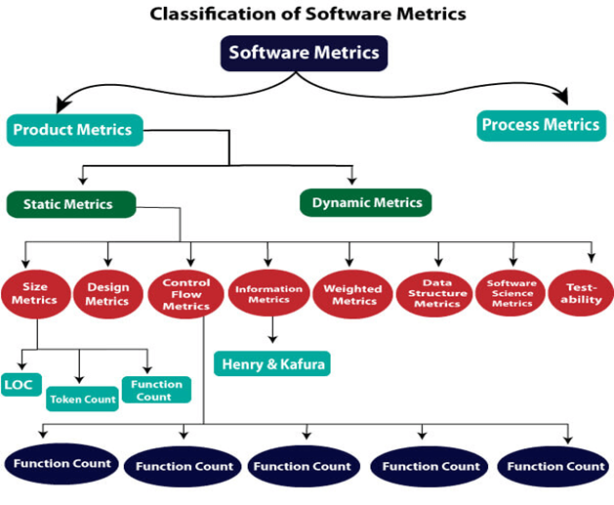

Slide 5
Metrics
Fan-in/Fan-out
Length of code
Cyclomatic complexity – measure of control complexity
Depth of conditional nesting
Length of identifiers
Fog index – Length of the words, sentences in documentation

Slide 6
Metrics for analysis model: These address various aspects of the analysis model such as system functionality, system size, and so on.
Metrics for design model: These allow software engineers to assess the quality of design and include architectural design metrics, component-level design metrics, and so on.
Metrics for source code: These assess source code complexity, maintainability, and other characteristics.
Metrics for testing: These help to design efficient and effective test cases and also evaluate the effectiveness of testing.
Metrics for maintenance: These assess the stability of the software product.

Slide 7
Metrics for Analysis model
Function point
lines of code are the commonly used methods for size estimation.

Slide 8
The function point metric, which was proposed by A.J Albrecht, is used to measure the functionality delivered by the system,
  number of errors
  estimate the number of components in the system.
Function point is derived by using a relationship between the complexity of software and the information domain value.
Information domain values used in function point include the number of external inputs, external outputs, external inquires, internal logical files, and the number of external interface files.

Slide 9
Lines of code (LOC) is one of the most widely used methods for size estimation. LOC can be defined as the number of delivered lines of code, excluding comments and blank lines.
From LOC, simple size-oriented metrics can be derived such as errors per KLOC (thousand lines of code),
  defects per KLOC
  cost per KLOC
  program complexity
  development effort
  programmer performance

Slide 10
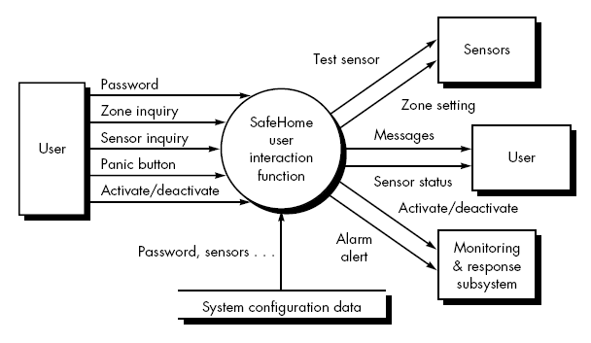

Slide 11
Product Metrics
Metrics for Analysis Model
Metrics for Design Model
Metrics for source code
Metrics for testing
Metrics for maintenance

Slide 12
Metrics for Design Model
In designing a product, it is very important to have efficient management of complexity.
We know that systems are generally complex as they have many interconnected components that make it difficult to understand.

Slide 13
Glass and Card
Structural Complexity
Data Complexity
System Complexity

Slide 14
Structural Complexity
Structural complexity depends upon fan-out for modules. It can be defined as :
S(k) = f²_{out}(k)
Where f_{out} represents fanout for module k (fan-out means number of modules that are subordinating module k).

Slide 15
Data Complexity
Data complexity is complexity within interface of internal module.
It is size and intricacy of data. For some module k, it can be defined as
D(k) = tot_var(k) / [f_{out}(k)+1]
Where tot_var is total number of input and output variables going to and coming out of module.

Slide 16
System Complexity
System complexity is combination of structural and data complexity. It can be denoted as
Sy(k) = S(k)+D(k)
When structural, data, and system complexity get increased, overall architectural complexity also gets increased.

Slide 17
Cyclomatic Complexity
The computation of Cyclomatic complexity can be done with help of a flow graph
Cyclomatic complexity= E - N + 2
Where, E is total number of edges and N is total number of nodes.

Slide 18
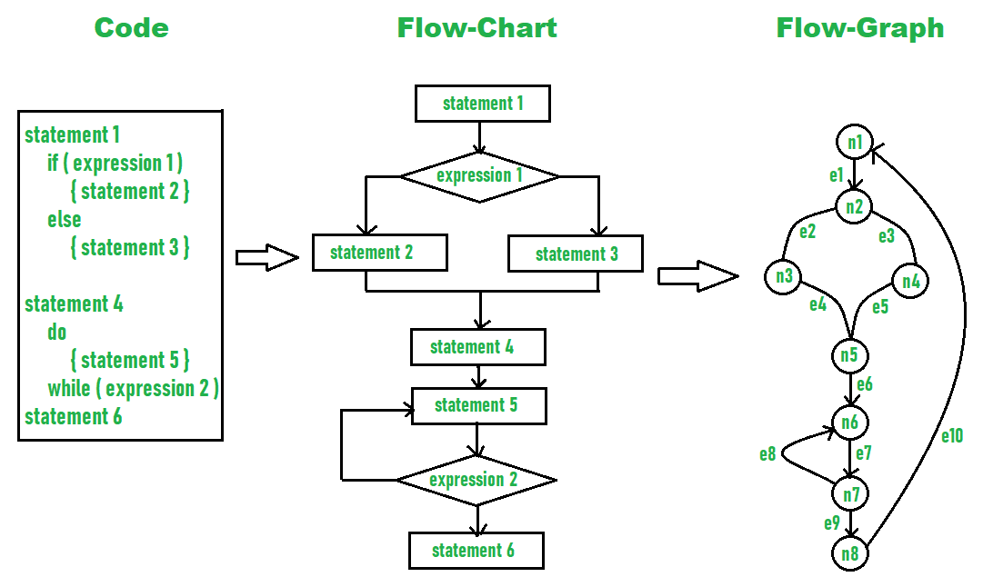

Slide 19
Given, E = 10, N = 8
So, Cyclomatic complexity = E - N + 2
= 10 – 8 + 2 = 4

Slide 20
Henry and Kafura Metric
An earlier high-level architectural design metric proposed by Henry and Kafura also makes use the fan-in and fan-out, applicable to call and return architectures,
HKM = length(i) x [ fin(i) + fout(i)]2
where length(i) is the number of programming language statements in a module i
fin(i) is the fan-in of a module i

Slide 21
Fenton Metrics
Fenton suggests a simple shape metrics that enable different program architectures to be compared using a set of straightforward dimensions.

Slide 22
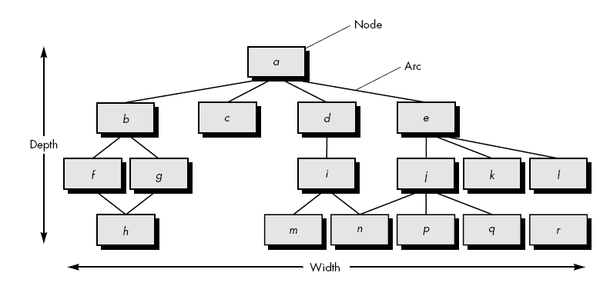

Slide 23
size = n + a
where n is the number of nodes and a is the number of arcs
depth = the longest path from the root (top) node to a leaf node
width = maximum number of nodes at any one level of the architecture
arc-to-node ratio, r = a/n,

Slide 24
DSQI
The U.S. Air Force Systems Command has developed a IEEE Std. 982.1-1988 , the Air Force uses Design Structure Quality Index (DSQI) that ranges from 0 to 1. The following values must be ascertained to compute the DSQI :
S1 = the total number of modules defined in the program architecture.
S2 = the number of modules whose correct function depends on the source of data input or that produce data to be used elsewhere
S3 = the number of modules whose correct function depends on prior processing.
S4 = the number of database items (includes data objects and all attributes that define objects).
S5 = the total number of unique database items.
S6 = the number of database segments (different records or individual objects).
S7 = the number of modules with a single entry and exit

Slide 25
Once values S1 through S7 are determined for a computer program, the following intermediate values can be computed:
Program structure: D1, where D1 is defined as follows: If the architectural design was developed using a distinct method (e.g., data flow-oriented design or object-oriented design), then D1 = 1, otherwise D1 = 0.
Module independence: D2 = 1 (S2/S1)
Modules not dependent on prior processing: D3 = 1 (S3/S1)
Database size: D4 = 1 (S5/S4)
Database compartmentalization: D5 = 1 (S6/S4)
Module entrance/exit characteristic: D6 = 1 (S7/S1)

Slide 26
With these intermediate values determined, the DSQI is computed in the following manner:
DSQI = wiDi
where i = 1 to 6, wi is the relative weighting of the importance of each of the intermediate values, and wi = 1 (if all Di are weighted equally, then wi = 0.167).

Slide 27
Metrics for Component-level Design
Cohesion metrics: Cohesiveness of a module can be indicated by the definitions of the following five concepts and measures.
Data slice: Defined as a backward walk through a module, which looks for values of data that affect the state of the module as the walk starts
Data tokens: Defined as a set of variables defined for a module
Glue tokens: Defined as a set of data tokens, which lies on one or more data slice
Superglue tokens: Defined as tokens, which are present in every data slice in the module
Stickiness: Defined as the stickiness of the glue token, which depends on the number of data slices that it binds.

Slide 28
Coupling Metrics: This metric indicates the degree to which a module is connected to other modules, global data and the outside environment. A metric for module coupling has been proposed, which includes data and control flow coupling, global coupling, and environmental coupling.
d_{i} = total number of input data parameters
c_{i} = total number of input control parameters
d_{o}= total number of output data parameters
c_{o}= total number of output control parameters
Measures for global coupling
g_{d}= number of global variables utilized as data
g_{c} = number of global variables utilized as control
Measures for environmental coupling
w = number of modules called
r = number of modules calling the modules under consideration

Slide 29
By using the above mentioned measures, module-coupling indicator (m_{c}) is calculated by using the following equation.
m_{c} = K/M
K = proportionality constant
M = d_{i} + (a*c_{i}) + d_{o}+ (b*c_{o})+ g_{d}+ (c*g_{c}) + w + r.

Slide 30
Metrics for Object-Oriented Design
Complexity: Determined by assessing how classes are related to each other
Coupling: Defined as the physical connection between OO design elements
Sufficiency: Defined as the degree to which an abstraction possesses the features required of it
Cohesion: Determined by analyzing the degree to which a set of properties that the class possesses is part of the problem domain or design domain

Slide 31
Primitiveness: Indicates the degree to which the operation is atomic
Similarity: Indicates similarity between two or more classes in terms of their structure, function, behavior, or purpose
Volatility: Defined as the probability of occurrence of change in the OO design

Slide 32
Size: Defined with the help of four different views, namely, population, volume, length, and functionality.
  Population is measured by calculating the total number of OO entities, which can be in the form of classes or operations.
  Volume measures are collected dynamically at any given point of time.
  Length is a measure of interconnected designs such as depth of inheritance tree.
  Functionality indicates the value rendered to the user by the OO application.

Slide 33
Metrics for Coding
Halstead proposed the first analytic laws, which can be derived once the code is generated
n_{l} = number of distinct operators in a program
n₂ = number of distinct operands in a program
N₁ = total number of operators
N₂= total number of operands.

Slide 34
By using these measures, Halstead developed an expression for overall program length, program volume, program difficulty, development effort
Program length (N) can be calculated by using the following equation.
N = n₁log₂n_{l} + n₂ log₂n₂
Program volume (V) can be calculated by using the following equation.
V = N log₂ (n₁+n₂).

Slide 35
Volume ratio (L)can be calculated by using the following equation.
L = Volume of the most compact form of a program / Volume of the actual program
Where, value of L must be less than 1.
Volume ratio can also be calculated by using the following equation.
L = (2/n₁)* (n₂/N₂).

Slide 36
Program difficulty level (D) and effort (E)can be calculated by using the following equations.
D = (n₁/2)*(N₂/n₂).
E = D * V.

Slide 37
Metrics for Software Testing
Halstead measures can be used to derive metrics for testing effort. By using program volume (V) and program level (PL),Halstead effort (e)can be calculated by the following equations.
e = V/ PL
Where
PL = 1/ [(n₁/2) * (N₂/n₂)] … (1)
For a particular module (z), the percentage of overall testing effort allocated can be calculated by the following equation.
Percentage of testing effort (z) = e(z)/∑e(i)
Where, e(z) is calculated for module z with the help of equation (1). Summation in the denominator is the sum of Halstead effort (e) in all the modules of the system.

Slide 38
A set of metrics proposed for OO testing is listed below.
Lack of cohesion in methods (LCOM): This indicates the number of states to be tested. LCOM indicates the number of methods that access one or more same attributes. The value of LCOM is 0, if no methods access the same attributes. As the value of LCOM increases, more states need to be tested.
Percent public and protected (PAP): This shows the number of class attributes, which are public or protected. Probability of adverse effects among classes increases with increase in value of PAP as public and protected attributes lead to potentially higher coupling.

Slide 39
Public access to data members (PAD): This shows the number of classes that can access attributes of another class. Adverse effects among classes increase as the value of PAD increases.
Number of root classes (NOR): This specifies the number of different class hierarchies, which are described in the design model. Testing effort increases with increase in NOR.
Fan-in (FIN): This indicates multiple inheritances. If value of FIN is greater than 1, it indicates that the class inherits its attributes and operations from many root classes.

Slide 40
Metrics for Software Maintenance
EEE have proposed Software Maturity Index (SMI), which provides indications relating to the stability of software product. For calculating SMI, following parameters are considered
Number of modules in current release (M_{T})
Number of modules that have been changed in the current release (F_{e})
Number of modules that have been added in the current release (F_{a})
Number of modules that have been deleted from the current release (F_{d})
SMI = [M_{T}– (F_{a}+ F_{e} + F_{d})]/M_{T}.

